Slide 1
Docker – wrapper around Software

Slide 2
Introduction
Docker is an open-source project that automates the deployment of applications inside software containers, by providing an additional layer of abstraction and automation of operating system–level virtualization on Linux.

Slide 3
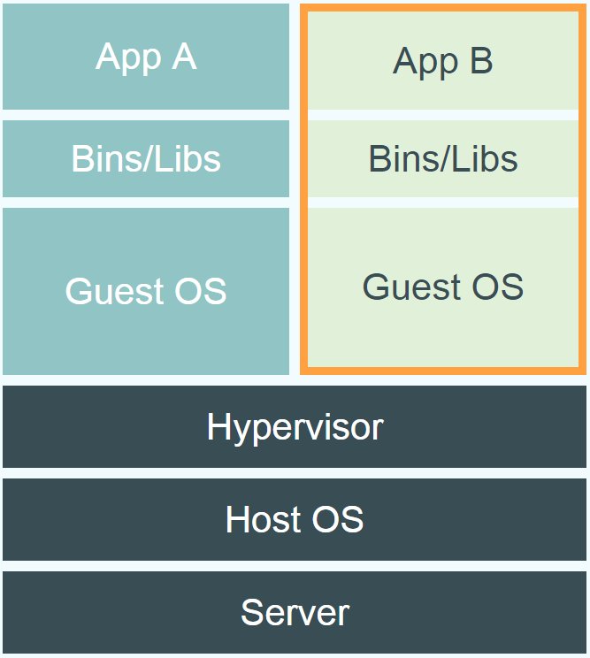
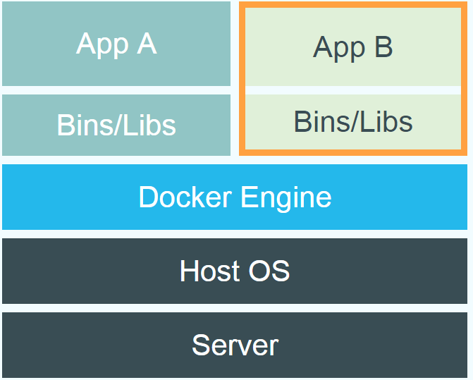
Dockers Vs. VM
Notes:
Virtual Machines
Each virtualized application includes not only the application - which may be only 10s of MB - and the necessary binaries and libraries, but also an entire guest operating system - which may weigh 10s of GB.
Docker
The Docker Engine container comprises just the application and its dependencies. It runs as an isolated process in userspace on the host operating system, sharing the kernel with other containers. Thus, it enjoys the resource isolation and allocation benefits of VMs but is much more portable and efficient.
Docker provides base images that contain OS installations we can start from: The OS is not more than an application running on the Kernel...

Slide 4
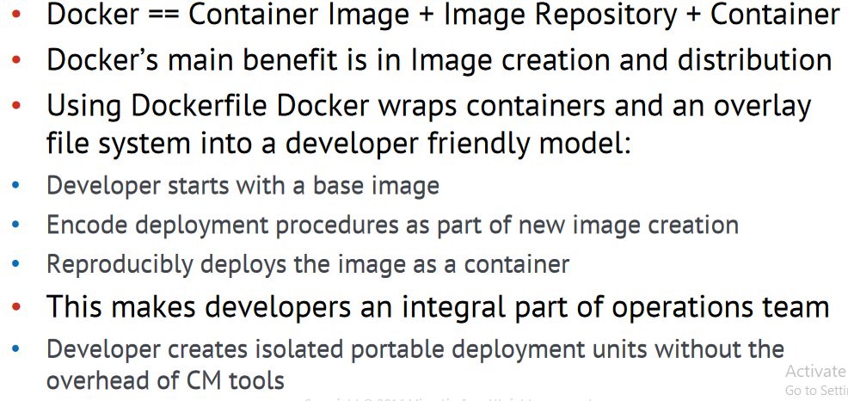
Dockers != Container
Notes:
Virtual Machines
Each virtualized application includes not only the application - which may be only 10s of MB - and the necessary binaries and libraries, but also an entire guest operating system - which may weigh 10s of GB.
Docker
The Docker Engine container comprises just the application and its dependencies. It runs as an isolated process in userspace on the host operating system, sharing the kernel with other containers. Thus, it enjoys the resource isolation and allocation benefits of VMs but is much more portable and efficient.
Docker provides base images that contain OS installations we can start from: The OS is not more than an application running on the Kernel...

Slide 5
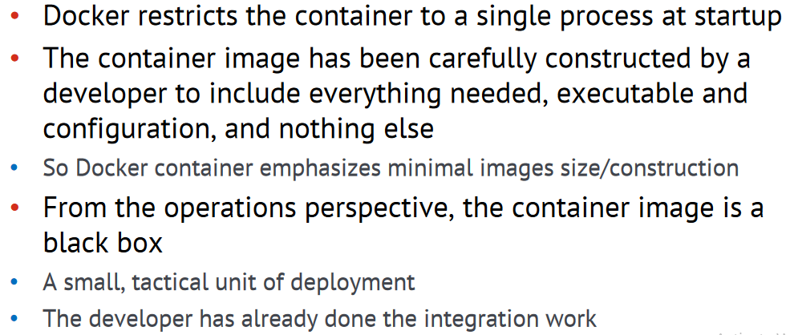
Application Containers

Slide 6
Image
Persisted snapshot that can be run
images: List all local images
run: Create a container from an image and execute a command in it
tag: Tag an image
pull: Download image from repository
rmi: Delete a local image , This will also remove intermediate images if no longer used

Slide 7
Container
Runnable instance of an image
ps: List all running containers
ps –a: List all containers (incl. stopped)
top: Display processes of a container
start: Start a stopped container
stop: Stop a running container
pause: Pause all processes within a container
rm: Delete a container
commit: Create an image from a container

Slide 8
Image Vs. Container
Base Image
ubuntu:latest
Container
cid1
cmd → new state
New Image
iid1
commit
Container
cid1
run
Container
cid2
Container
cid3
Container
cid4

Slide 9
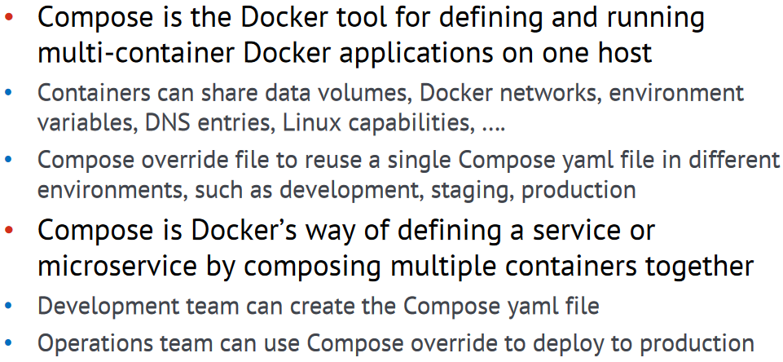
Docker Compose – Docker way of Microservices

Slide 10
Lab : Docker
Docker Command Reference : https://docs.docker.com/engine/reference/run/

Slide 11
Thanks!
Any questions?
You can find me at @username & user@mail.me

